Slide 1

Predicting Urban Traffic Congestion Patterns Using Distributed Analytics of Smart City Sensor Data
Alvin

Slide 2
Introduction & Background
Urban traffic congestion is worsening due to rapid urbanisation and rising vehicle density (Lu et al., 2023)
Smart cities use IoT sensors, cameras and connected devices for real-time traffic monitoring (Mutambik, 2025)
Existing systems are reactive they detect congestion after it occurs rather than predicting it (Musa et al., 2023)
Big data generated by SCATS sensors exceeds the capacity of traditional sequential processing tools
Distributed analytics and predictive modelling are essential for proactive smart city traffic management

Slide 3
Literature Review
IoT-based sensor networks enable real-time traffic data collection across urban intersections
Apache Spark outperforms Hadoop for iterative ML workloads and real-time streaming (Theodorakopoulos et al., 2025)
Random Forest handles non-linear traffic relationships and high-dimensional sensor data effectively
GRU outperforms LSTM for traffic prediction with fewer parameters and lower computational cost (Abdullah et al., 2023)
Existing works lack integration of scalable distributed processing with predictive congestion modelling

Slide 4
Literature Review
Author (Year) | Method | Advantage | Disadvantage
Musa et al. (2023) | IoT-based ITS | Real-time data capture | No large-scale predictive analytics
Abduljabbar et al. (2025) | ML traffic flow prediction | Multi-source data, accurate | No distributed big data processing
Theodorakopoulos et al. (2025) | Apache Spark MLlib | Scalable ML training | Not applied to urban traffic prediction
Abdullah et al. (2023) | Soft GRU deep learning | Captures time-dependent patterns | High computational demand
Chahal et al. (2023) | ARIMA + LSTM hybrid | Improved forecasting accuracy | No distributed big data integration

Slide 5
Problem Statement
Most traffic systems depend on reactive monitoring without advanced predictive capabilities (Musa et al., 2023)
Existing ML models improve accuracy but lack scalable distributed processing integration (Abduljabbar et al., 2025)
Apache Spark exists for large-scale analytics but has seen limited use in traffic prediction (Theodorakopoulos et al., 2025)
No unified framework integrates IoT sensor data, distributed processing, and real-time prediction together
Research gap: scalable end-to-end framework combining Kafka streaming, Spark processing, and hybrid ML/DL prediction is missing

Slide 6
Research Aim and Objectives
Research Aim:
Develop a scalable big data-driven framework integrating distributed analytics and predictive modelling for urban traffic congestion forecasting
Objectives:
Objective 1: Build a scalable Apache Spark framework for distributed processing of SCATS traffic data
Objective 2: Implement Random Forest and GRU models for hybrid ML and DL traffic congestion prediction
Objective 3: Design a live Tableau dashboard and evaluate system scalability, accuracy, and real-time capability
Dataset: SCATS August 2025 — 10.78 million records from Dublin City Council signalised intersections

Slide 7
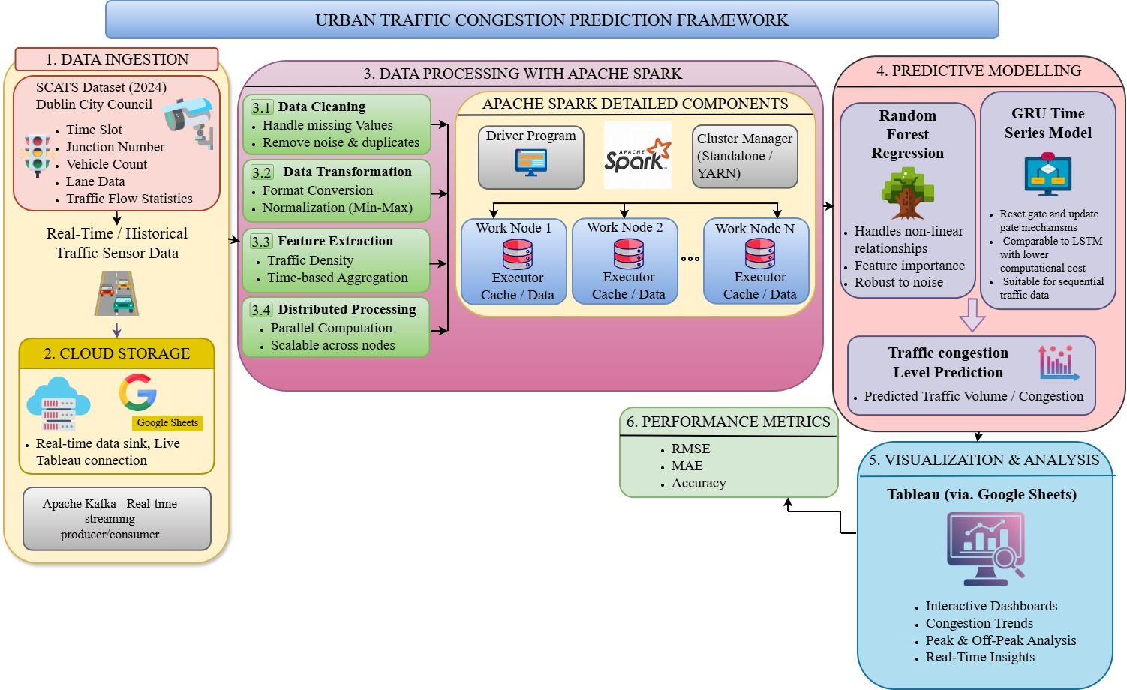
Methodology & System Architecture
Four-layer distributed architecture: Data Ingestion → Preprocessing → Predictive Modelling → Visualisation
Apache Kafka producer streams SCATS records row by row to the Kafka topic in real time
Apache Spark Structured Streaming consumer applies preprocessing and RF model inference on each micro-batch
Prediction outputs written automatically to Google Sheets, live-connected to Tableau dashboard
MinMaxScaler normalisation and Label Encoding applied; features: Region, Site, Detector, Hour, Day, Peak_Hour, Avg_Volume
Proposed Scalable Distributed Architecture

Slide 8
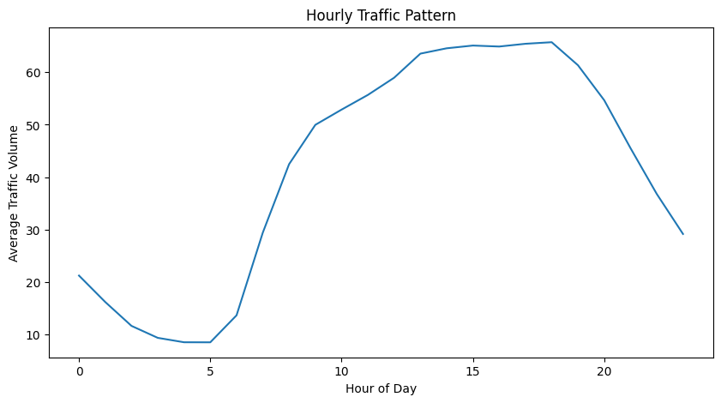
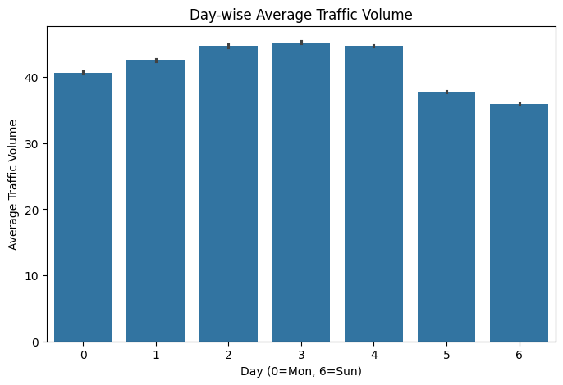
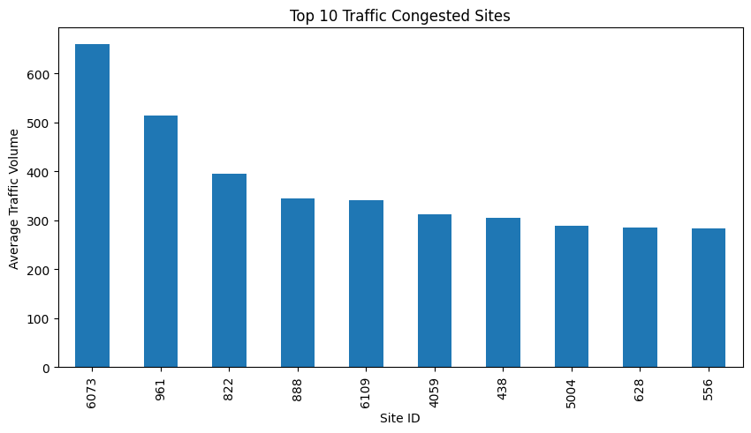
Exploratory Data Analysis
NCITY region records highest average traffic volume (~53 vehicles); DCC2 records lowest (~21)
Clear daily bimodal pattern: trough at 4–5am (~9 vehicles), afternoon peak 1pm–6pm (~65 vehicles)
Wednesday and Thursday show highest day-wise volumes (~44–45 vehicles); Sunday lowest (~36)
Site 6073 is the most congested intersection with ~655 average vehicles 27% higher than Site 961
Strong positive correlation between Sum_Volume and Avg_Volume (r = 0.99); Detector negatively correlated (r = –0.38)

Slide 9
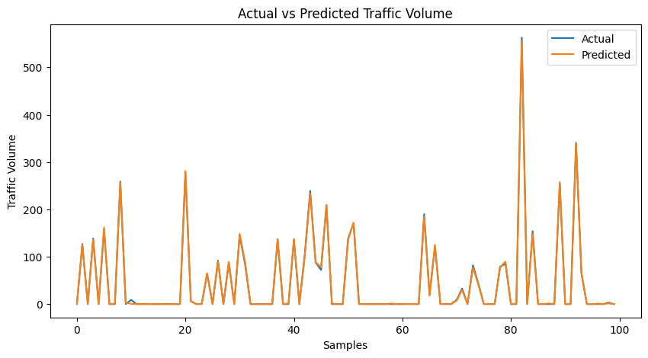
Random Forest Implementation & Results
RandomForestRegressor: 50 estimators, max depth 15, 80/20 train-test split
Features used: Region, Site, Detector, Hour, Day, Peak_Hour, Avg_Volume; target: Sum_Volume
Congestion classified as Low / Medium / High using 60th and 90th percentile thresholds
Achieved R² = 0.9949, MAE = 1.52, RMSE = 7.32 — prediction within 1–2 vehicles per 15-min interval
Model saved as model.pkl, scaler.pkl, label_encoder.pkl for reuse in the streaming pipeline

Slide 10
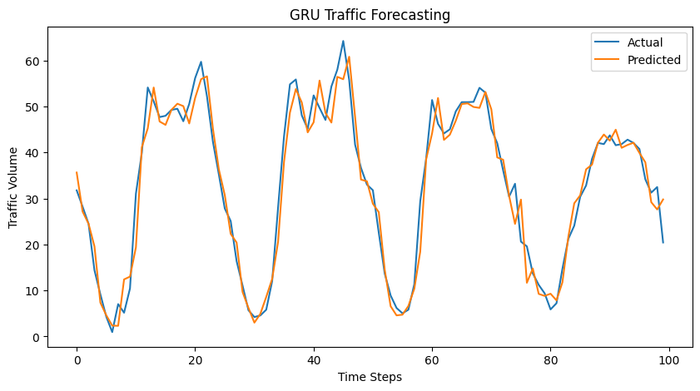
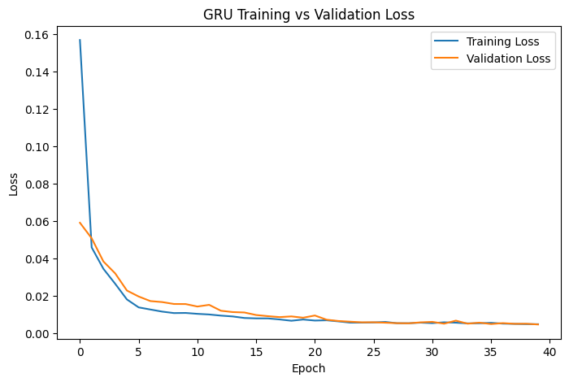
GRU Model Implementation & Results
Most active site selected; data hourly resampled and scaled; 48-hour lookback window applied
Two stacked GRU layers (64 → 32 units) + two dense layers; 22,817 trainable parameters total
Early stopping (patience = 5) applied over 40 epochs; both training and validation loss converged below 0.01
Achieved R² = 0.9472, MAE = 2.82, RMSE = 3.81 smoother forecasting with fewer extreme errors than RF
GRU successfully captured recurring daily traffic wave cycles from 0 to ~65 vehicles
Layer | Type | Output Shape | Parameters
Input | — | (48, 1) | 0
gru | GRU | (48, 64) | 12,864
gru_1 | GRU | (32) | 9,408
dense | Dense (ReLU) | (16) | 528
dense_1 | Dense | (1) | 17
Total |  |  | 22,817

Slide 11
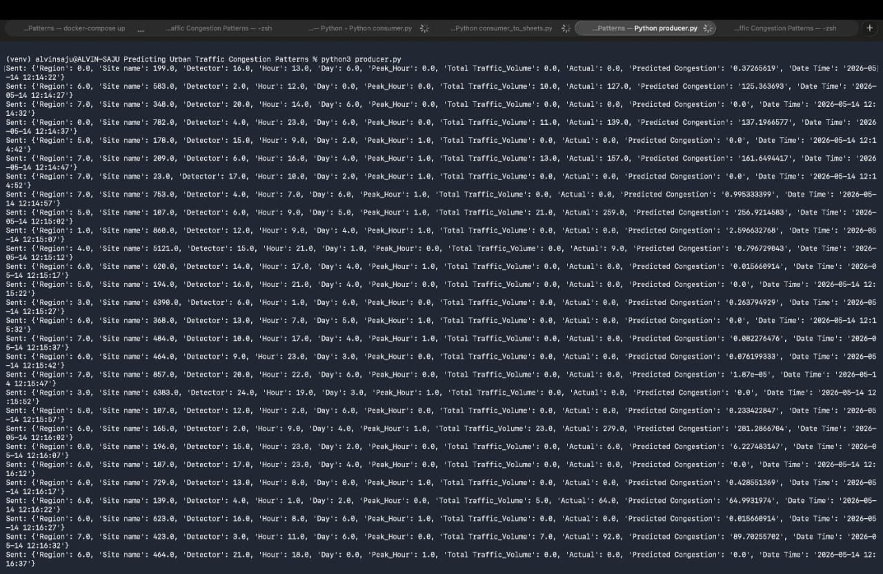
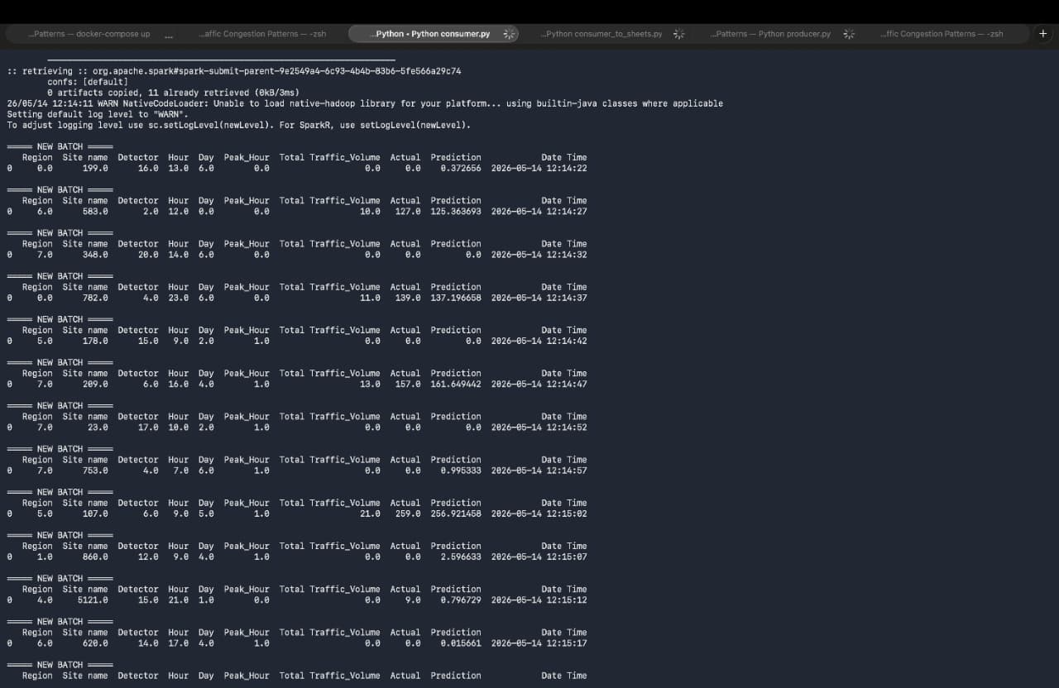
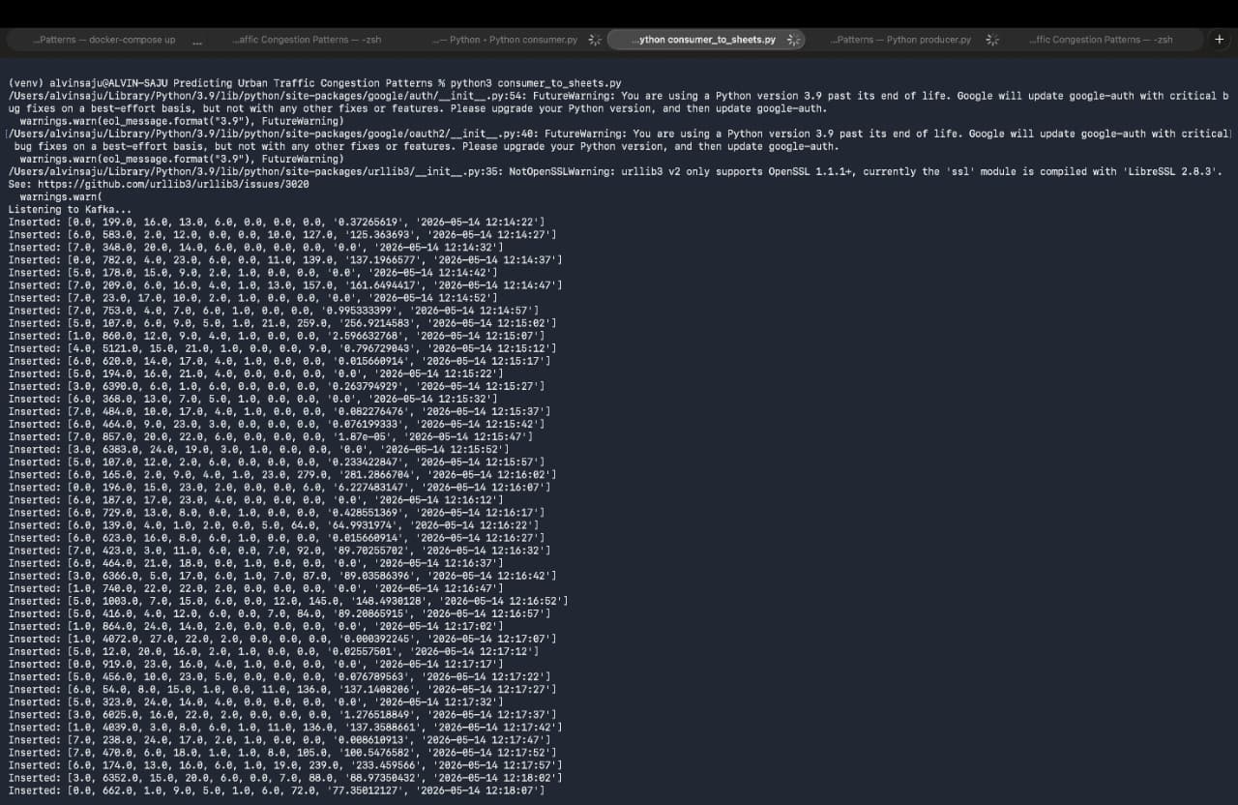
Real-Time Streaming Pipeline
Kafka producer streams SCATS records row by row with fields: Region, Site, Detector, Hour, Day, Peak_Hour, Timestamp
Spark Structured Streaming consumer loads saved RF model and scaler; applies inference on every incoming micro-batch
Predicted congestion level and actual values written to Google Sheets approximately every 5 seconds
Google Sheets live-connected to Tableau; dashboard auto-refreshes as new rows are inserted
Live demonstration confirmed successful end-to-end streaming on 14 May 2026 from 12:14 onwards
Producer Terminal Output
Spark Consumer Terminal Output
Consumer to Google Sheets Terminal Output

Slide 12
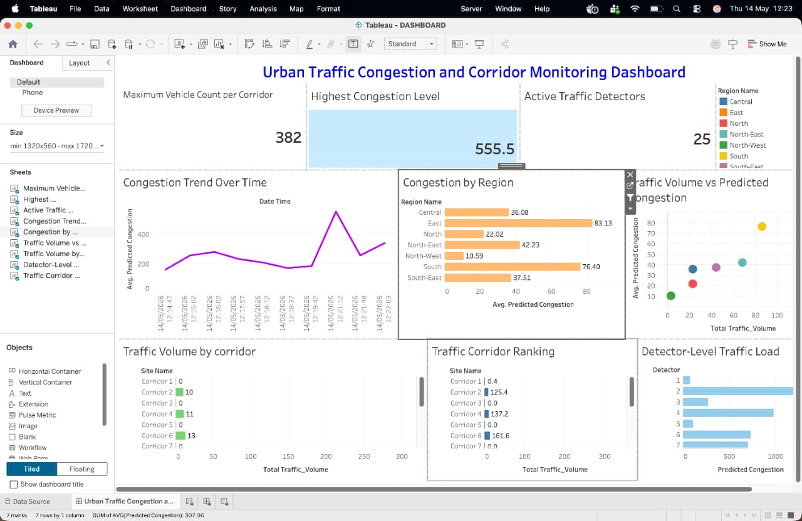
Testing, Evaluation & Dashboard
RF model achieves R² = 0.9949 and MAE = 1.52; GRU achieves R² = 0.9472 and RMSE = 3.81 (smoother errors)
Spark processed 10.78 million records with continuous micro-batch streaming - no memory overflow or interruption
East region highest predicted congestion (83.13); South second (76.40); North lowest (22.02)Site 6073 confirmed as critical network hotspot with ~655 average vehicles - priority for signal optimization
Tableau dashboard displayed 6 live panels: KPI cards, congestion trend, regional comparison, corridor ranking, detector load, scatter plot
Fig: Tableau Dashboard
Metric | Random Forest | GRU
MAE | 1.52 | 2.82
RMSE | 7.32 | 3.81
R² Score | 0.9949 | 0.9472
Model Performance Comparison

Slide 13
Conclusions & Future Work
All three objectives met: Spark processed 10.78M records; RF (R²=0.9949) and GRU (R²=0.9472) validated; live Tableau dashboard deployed
Real-time Kafka–Spark–Google Sheets–Tableau pipeline demonstrated successfully in live demo
Limitations: single-month Dublin dataset; tested on local hardware rather than cloud cluster
Future work: deploy on AWS EMR / Google Cloud Dataproc for multi-city scalability testing
Future work: integrate weather/incident data; replace GRU with Temporal Fusion Transformer; develop REST API layer for navigation app integration

Slide 14
References
Abduljabbar, R., Dia, H. and Liyanage, S. (2025) "Machine Learning Traffic Flow Prediction Models for Smart and Sustainable Traffic Management," Infrastructures, 10(7). https://doi.org/10.3390/infrastructures10070155
Abdullah, S.M. et al. (2023) "Optimizing Traffic Flow in Smart Cities: Soft GRU-Based Recurrent Neural Networks for Enhanced Congestion Prediction Using Deep Learning," Sustainability, 15(7). https://doi.org/10.3390/su15075949
Alexakis, T. et al. (2022) "A Distributed Big Data Analytics Architecture for Vehicle Sensor Data," Sensors, 23(1). https://doi.org/10.3390/s23010357
Chahal, A. et al. (2023) "A Hybrid Univariate Traffic Congestion Prediction Model for IoT-Enabled Smart City," Information, 14(5). https://doi.org/10.3390/info14050268
Lu, H. et al. (2023) "Study on Urban Expansion and Population Density Changes Based on the Inverse S-Shaped Function," Sustainability, 15(13). https://doi.org/10.3390/su151310464
Musa, A.A. et al. (2023) "Sustainable Traffic Management for Smart Cities Using Internet-of-Things-Oriented Intelligent Transportation Systems (ITS): Challenges and Recommendations," Sustainability, 15(13). https://doi.org/10.3390/su15139859
Mutambik, I. (2025) "IoT-Enabled Adaptive Traffic Management: A Multiagent Framework for Urban Mobility Optimisation," Sensors, 25(13). https://doi.org/10.3390/s25134126
SCATS dataset (2024). Available at: https://data.smartdublin.ie/dataset/dcc-scats-detector-volume-jan-jun-2024 (Accessed: April 2, 2026)
Theodorakopoulos, L., Karras, A. and Krimpas, G.A. (2025) "Optimizing Apache Spark MLlib: Predictive Performance of Large-Scale Models for Big Data Analytics," Algorithms, 18(2). https://doi.org/10.3390/a18020074

Slide 15
Thank You !

